Slide 1
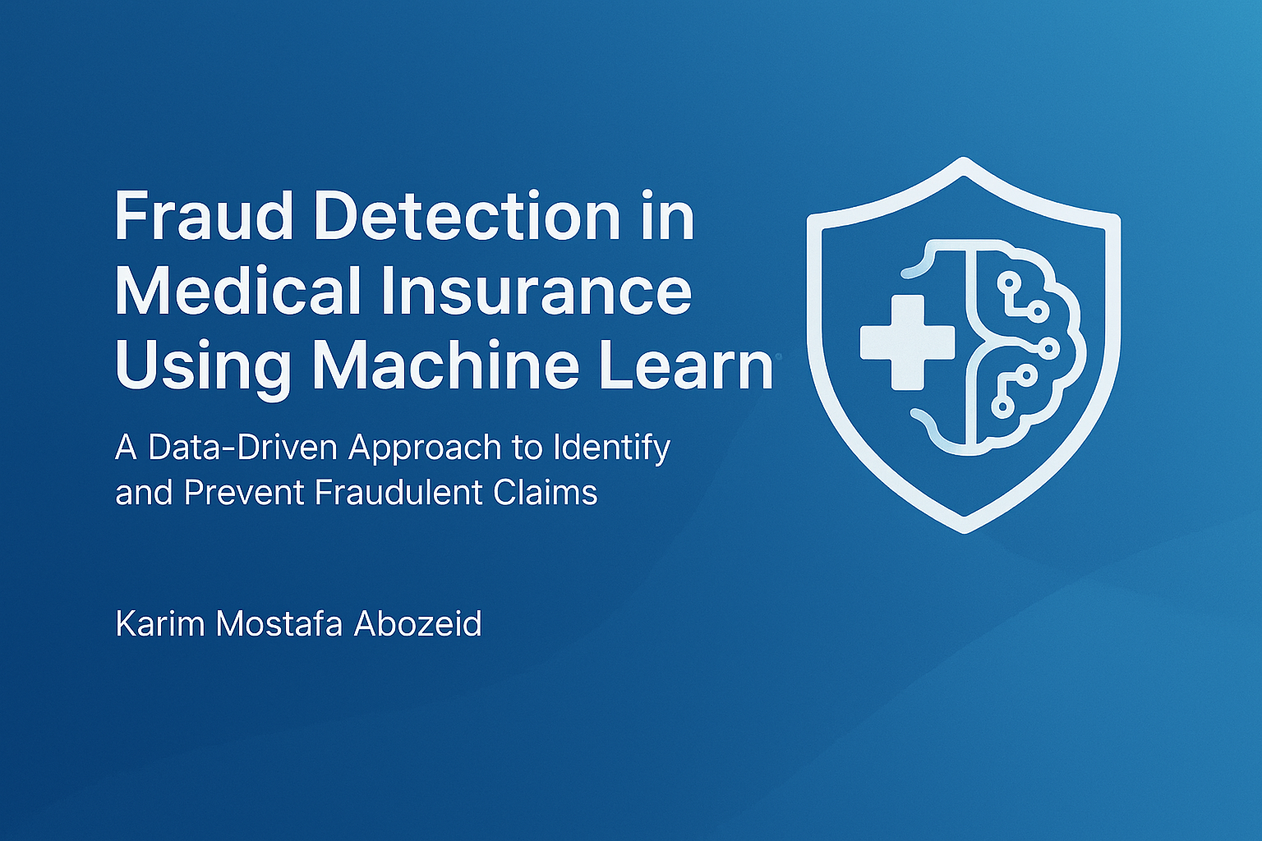
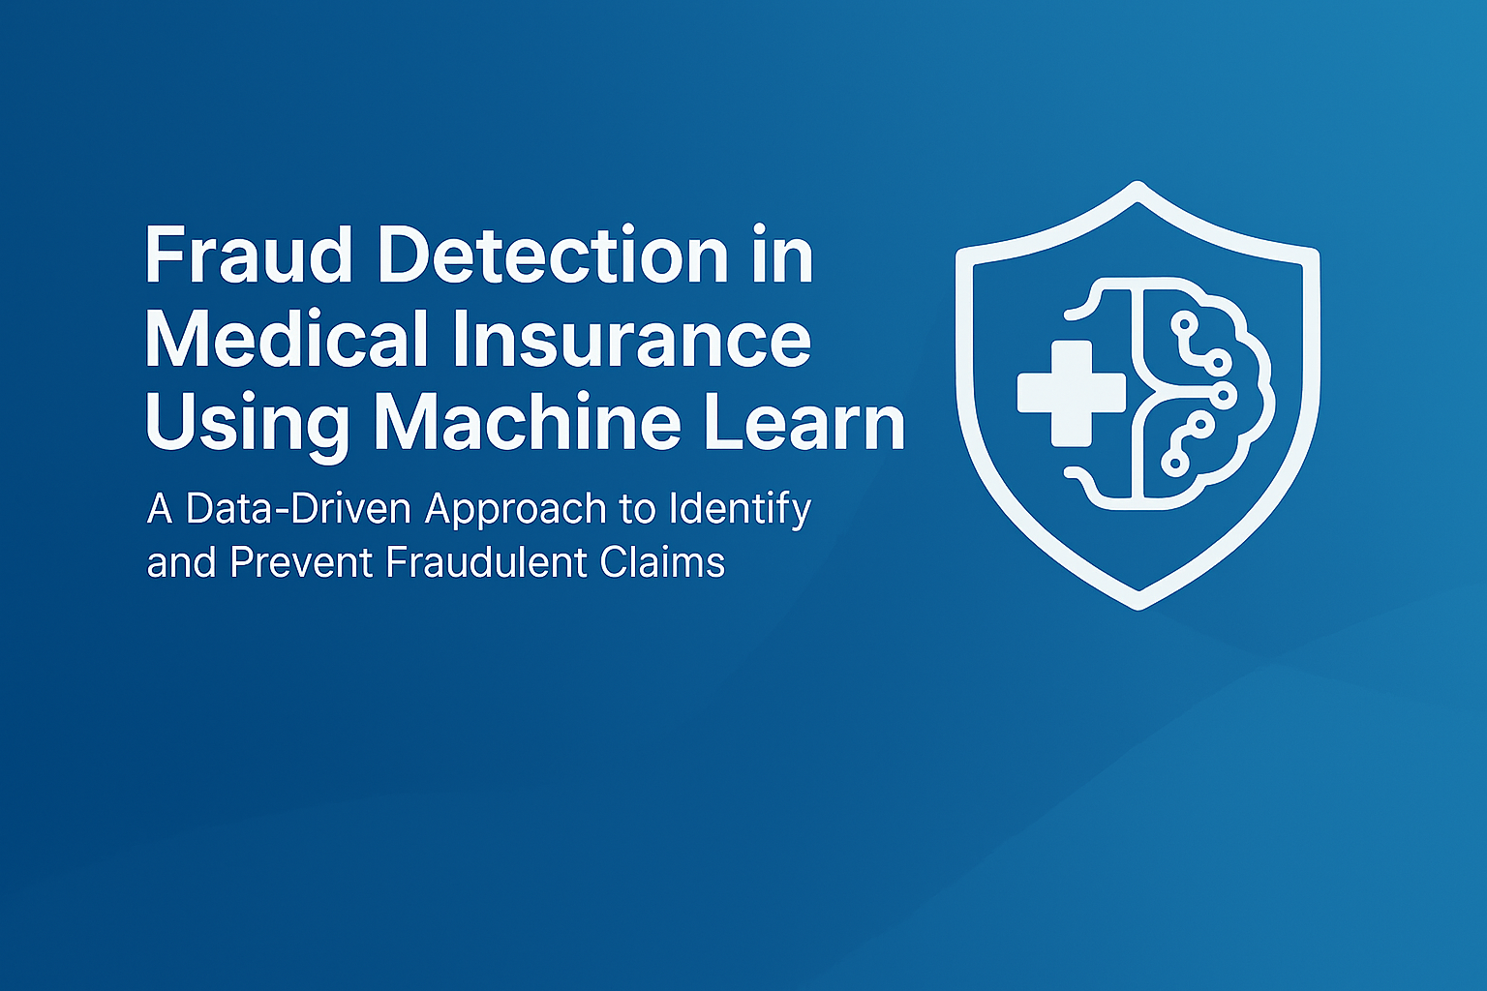
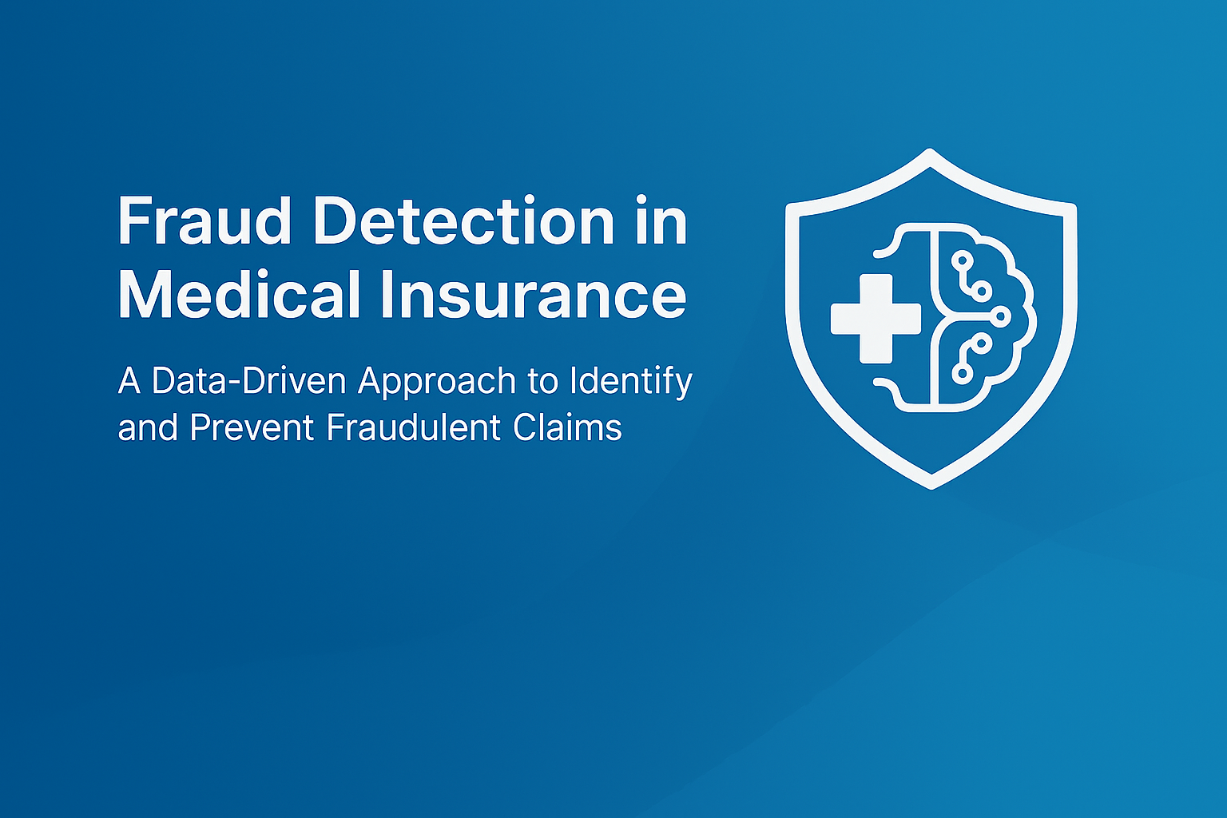

Slide 2

Main Problem

Slide 3
Main Problem
Healthcare Fraud Is Costly, Hidden, and Difficult to Detect
The healthcare insurance system processes millions of claims across beneficiaries, hospitals, and providers.
Fraudulent providers exploit the system through inflated claims, unnecessary procedures, manipulated diagnoses, and repeated billing patterns.
These fraudulent activities cause billions in financial losses and reduce resources available for legitimate patient care.
Traditional rule-based detection methods fail because fraud patterns are:
Complex
Evolving
Hard to identify manually
There is a need for an automated, data-driven solution capable of identifying suspicious providers early and accurately.

Slide 4
Causes of Fraud in Medical Insurance
Billing fraud: charging for services not provided
Upcoding: claiming more expensive procedures
Unnecessary services: tests/admissions done just to bill
Identity misuse: stolen or shared insurance IDs
False patient information
Provider–patient collusion
Weak verification systems (poor auditing, weak checks)

Slide 5

Our Goal
Detect
Detect fraudulent medical insurance claims
Reduce
Reduce financial losses for the insurer
Improve
Improve accuracy by minimizing false negatives (missed fraud cases)
Provide
Provide a reliable model to support decision-making

Slide 6
Methodology

Slide 7
Fraud Detection System
We designed a data driven model that identifies high risk providers
It covers all types of healthcare fraud and minimizes false positives

Slide 8
Data Cleaning Overview
Standardized and validated key fields (dates, patient info, procedures, diagnoses)
Removed duplicates and handled missing or inconsistent claim entries
Verified financial fields and preserved original reimbursement values
Aggregated claims at patient level, physician level, and hospital level to identify behavioral patterns
Ensured clean, trustworthy data foundation to support accurate fraud detection and model training

Slide 9
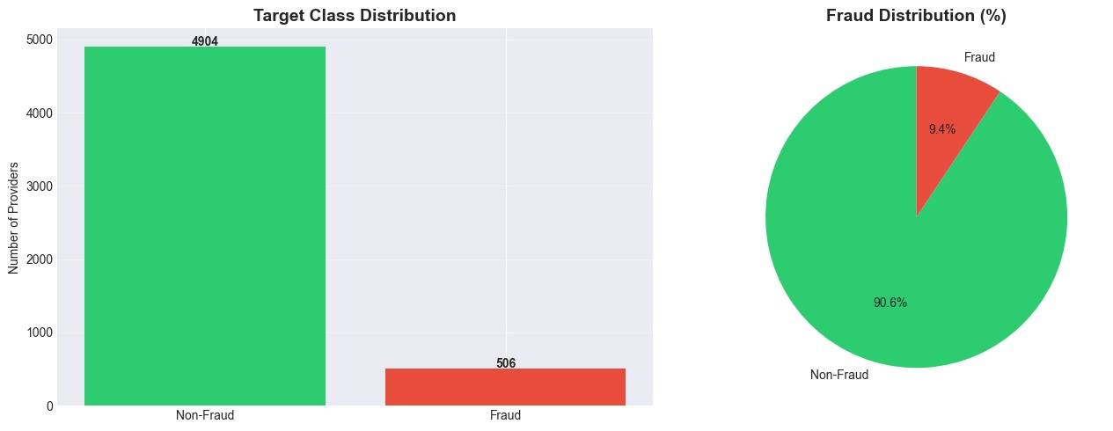
The process to the best model
First of all, the data is imbalanced with a fraud rate of 9% to 10% thus training without imbalance correction causes models to label everything as "non-fraud".

Slide 10
Models used and Evaluated
Random Forest : Ensemble of decision trees using bagging and feature randomness. Good baseline for tabular data.
XGBoost : Gradient-boosted trees optimized for speed and regularization. Strong predictive power on structured data.
Logistic Regression : Linear probabilistic model; interpretable baseline.
Gradient Boosting : Traditional gradient boosting (scikit-learn) used as an additional ensemble variant.

Slide 11
Base line evaluation
Gradient Boosting and XGBoost performed almost identically, even though XGBoost is generally more expressive and can handle complex relationships better.
Logistic Regression performed the weakest, especially in precision. It hovered around 0.40 precision, although its recall remained high (~0.90).
Random Forest was competitive, roughly on the same level as GB/XGB before tuning.RF shows similar recall but slightly more volatility in probability outputs.
From these baselines, Gradient Boosting and Random Forest came out as the most promising candidates, with GB having a natural edge due to smoother probability distributions and lower overfitting risk compared to its bigger brother, XGBoost.

Slide 12
Why Recall Matters
Missing a fraudulent provider (false negative) is more costly
Recall was prioritized throughout the tuning process

Slide 13
How We Tuned
Used Average Precision (AP) as the scoring metric
AP rewards good ranking quality (threshold-independent)
Avoids optimizing recall at 0.5, which is irrelevant post-thresholding

Slide 14
Calibration
Why Calibration
Raw model probabilities can be distorted
Fraud probabilities need to be stable and monotonic
Threshold tuning only works well on calibrated outputs
What We Used
Isotonic regression for all models
Most impactful for Gradient Boosting and XGBoost
Produces smoother, more reliable probability estimates

Slide 15
Threshold optimization
Why Not Use 0.5?
Fraud probability distributions are skewed
Default threshold ignores recall requirements
We need a cutoff tailored to the actual goal
Our Approach
Sweep 2,000–5,000 thresholds
Choose the threshold that:
Achieves high recall (≥ target)
Maximizes precision at that recall level

Slide 16
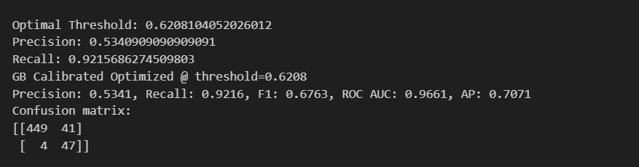
Results of Gradient boosting

Slide 17
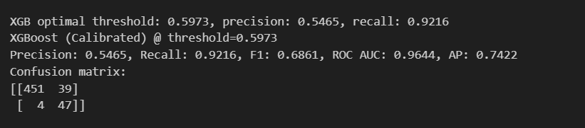
Results of XG Boost

Slide 18
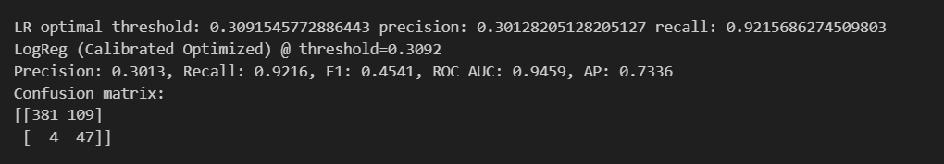
Results of Logistic Regression

Slide 19
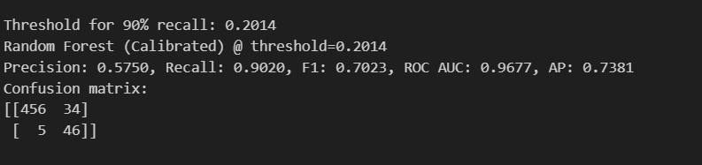
Results of Random Forest

Slide 20
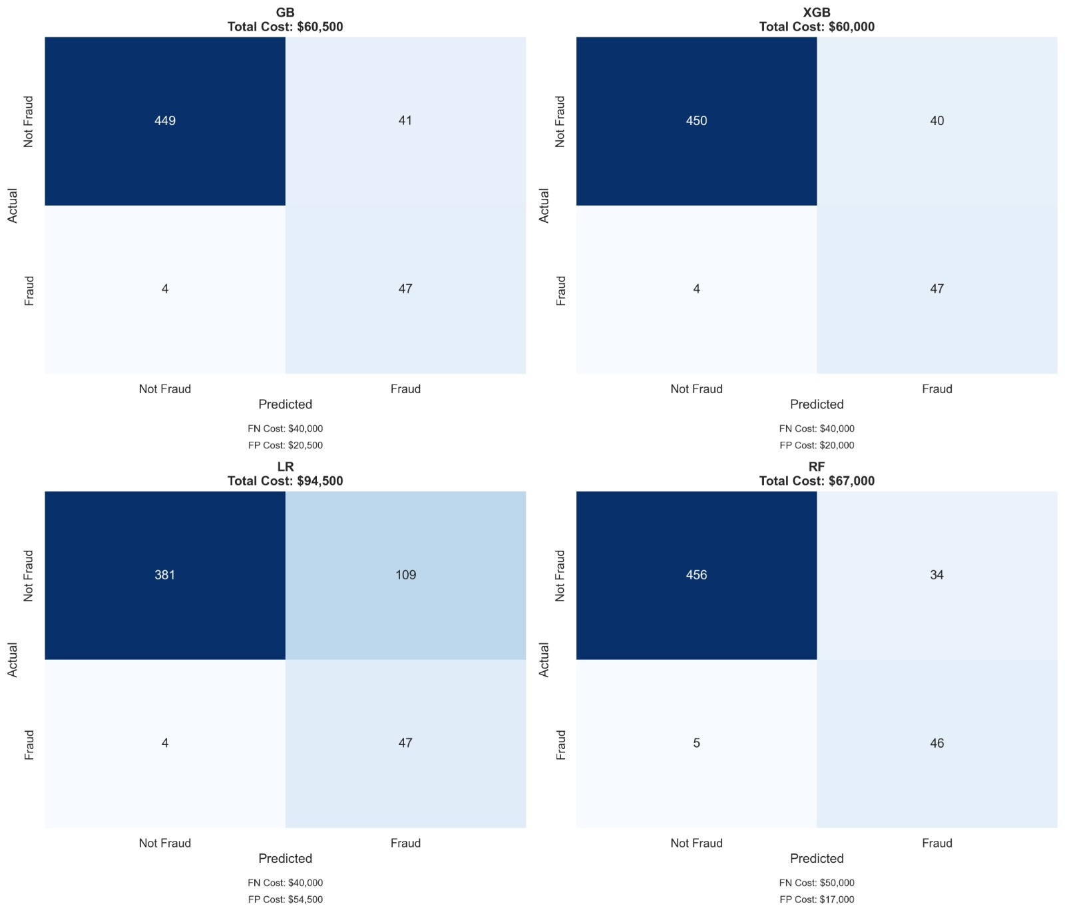
All models confusion matrix

Slide 21
Final Model Choice
Why Random Forest Was Selected
Best Precision–Recall Balance
Recall: 0.90 (captures most fraud cases)
Precision: 0.58 (lowest false-alarm rate among high-recall models)
Most Stable Model After Tuning
Consistent performance across folds
Smooth calibration curve compared to XGBoost & Gradient Boosting
Low Overfitting Risk
Robust on imbalanced medical claims data
More reliable than XGBoost for our dataset size
Outperformed Other Models
Gradient Boosting: good recall but lower precision
XGBoost: strong but more overfitting
Logistic Regression: poor precision on non-linear patterns

Slide 22
Error Analysis
False Positives:
Case studies suggest the model may overreact to providers with large patient panels or high claim activity,even when the activity is legitimate. More context-aware features could help reduce such misclassifications.
False Negatives:
Case studies suggest the model may have difficulty identifying busy, high-chronic-burden providers, whose activity appears plausible, indicating that more behavior-based features could help improve detection.

Slide 23
Business Impact
Reduces Financial Losses Detects high-risk fraudulent providers early, lowering unnecessary payouts.
Improves Audit Efficiency Prioritizes suspicious claims so investigators focus on the highest-value cases.
Protects Legitimate Patients & Providers Minimizes disruption to honest providers by reducing false alarms.
Enhances Compliance & Risk Management Supports regulatory reporting and strengthens fraud-prevention policies.
Scalable for Future Growth Model can adapt as new claim patterns and fraud techniques emerge.

Slide 24
THANK YOU!!! :D
Omar Hossam
Omar Hany
Karim Mostafa
Ramez Mokbil

